Slide 1
Yu. Senichev
HESR quadrupole and sextupole grouping
IKP seminar, 1 March 2011
Yu. Senichev, FZJ

Slide 2
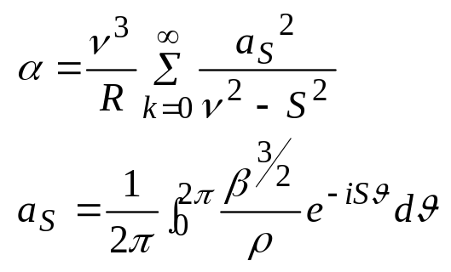
Transition energy: number of quadrupole families
The transition energy is defined as
To influence effectively on the transition energy the quadrupole grouping number S must be bigger than the horizontal v<S
IKP seminar, 1 March 2011
Yu. Senichev, FZJ

Slide 3
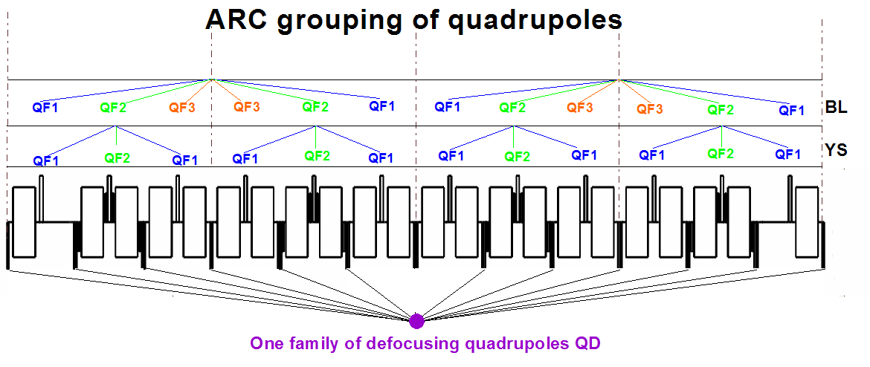
Two and four superperiodicity of arc
Two types of grouping:
IKP seminar, 1 March 2011
Yu. Senichev, FZJ

Slide 4
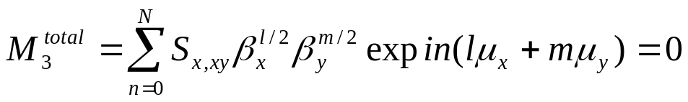
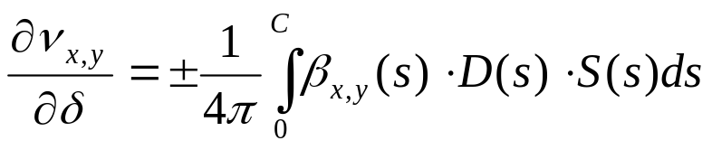
Chromaticity correction and sextupole non-linear effect: number of sextupole families
Non-linear effect ~
Chromaticity suppressing
IKP seminar, 1 March 2011
Yu. Senichev, FZJ

Slide 5
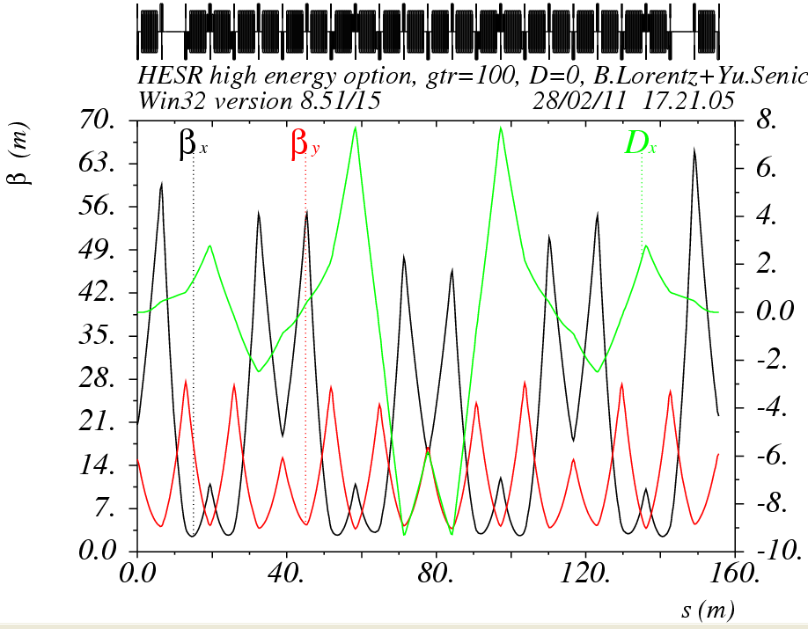
Chromaticity correction and sextupole non-linear effect: number of sextupole families
IKP seminar, 1 March 2011
Yu. Senichev, FZJ

Slide 6
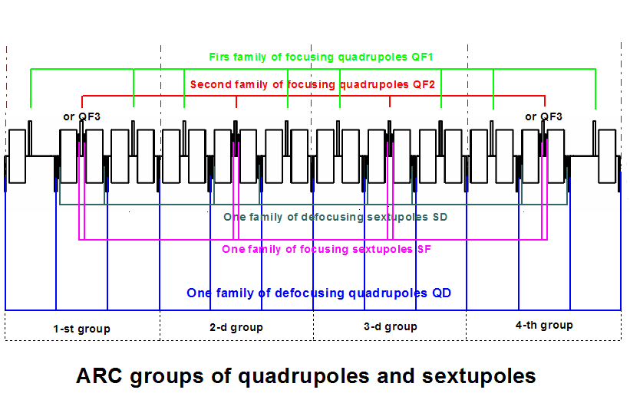
Transition energy: number of quadrupole families
IKP seminar, 1 March 2011
Yu. Senichev, FZJ

Slide 7
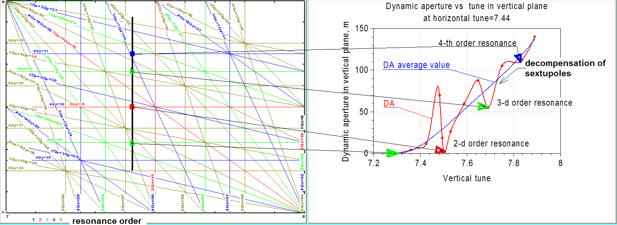
Chromaticity correction and sextupole non-linear effect: number of sextupole families
DA vs phase advance: at ν^{arc}_{x,y}→3.0 the cell tune →π/2 and DA grows
IKP seminar, 1 March 2011
Yu. Senichev, FZJ

Slide 8
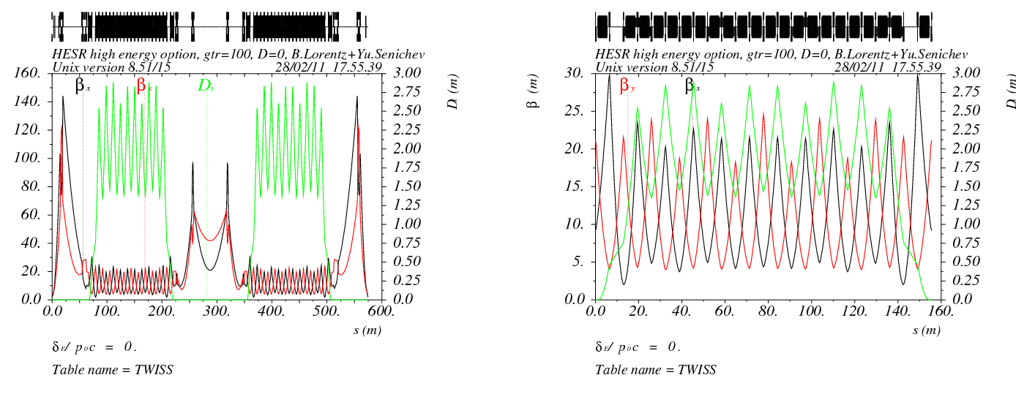
Low Transition Energy lattice
TWISS function:
RING ARC
IKP seminar, 1 March 2011
Yu. Senichev, FZJ

Slide 9
DA for LTE option without errors >1000 mm mrad for both planes
Phys aperture is limited by the quadrupole aperture and equals
A_{x,y}=75/85 mm mrad
IKP seminar, 1 March 2011
Yu. Senichev, FZJ

Slide 10
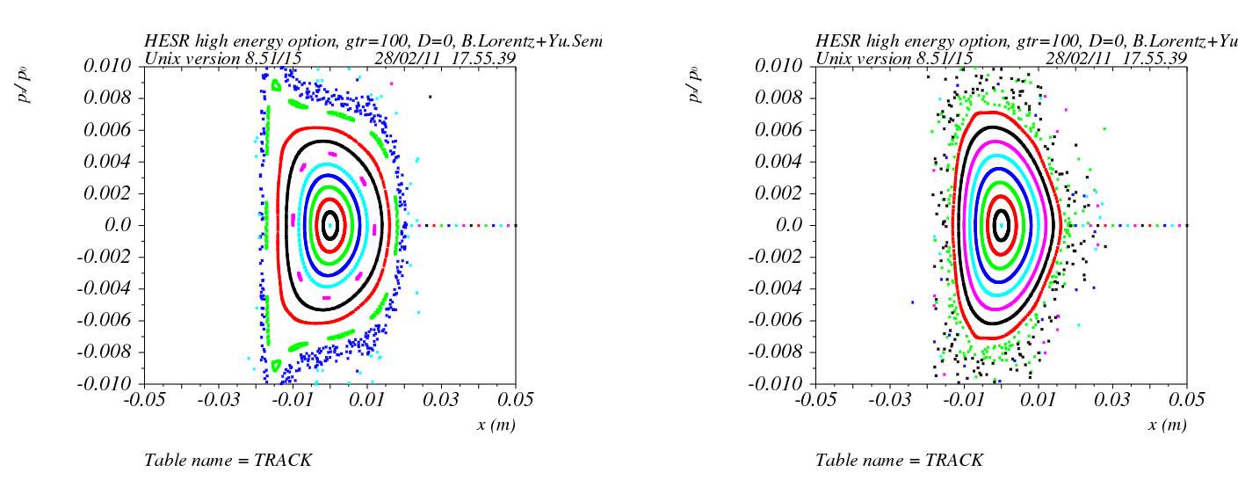
DA for LTE option with all errors >60 mm mrad for both planes
X plane dp/p=0.3%(a) X plane dp/p=0.0%(b)
IKP seminar, 1 March 2011
Yu. Senichev, FZJ

Slide 11
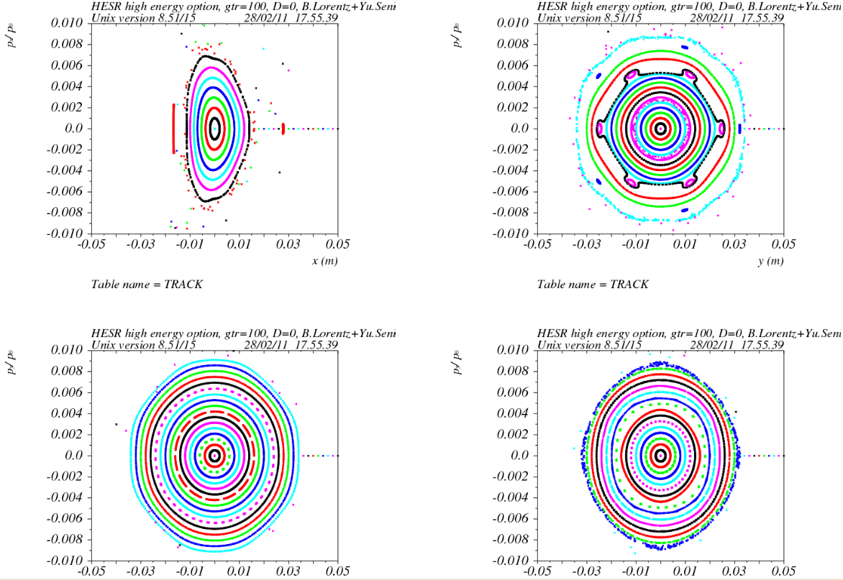
DA for LTE option with all errors >60 mm mrad for both planes
Figure: X plane dp/p=-0.3% (a); Y plane dp/p=0.3%;(b) 0.0%(c); -0.3%(d)
IKP seminar, 1 March 2011
Yu. Senichev, FZJ

Slide 12
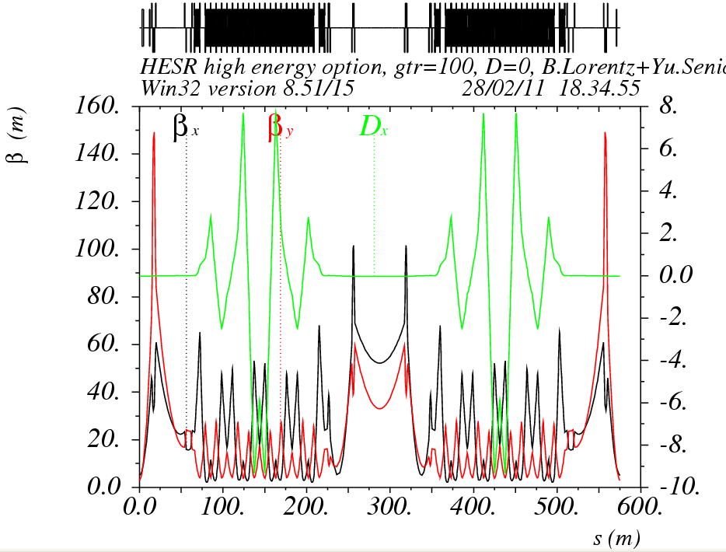
High Transition Energy (γ_{t}~i20) lattice
TWISS function
IKP seminar, 1 March 2011
Yu. Senichev, FZJ

Slide 13
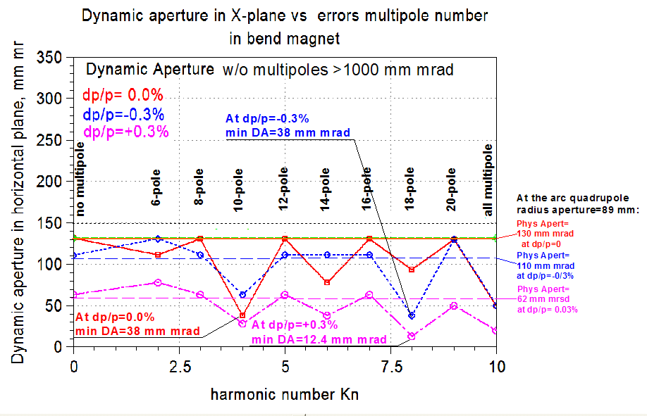
DA for HTE option with errors for monochromatic beam~40 mm mrad and at dp/p=±0.3% DA→10 mm mrad
IKP seminar, 1 March 2011
Yu. Senichev, FZJ

Slide 14
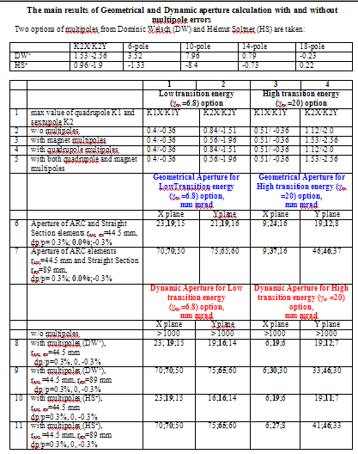
Table
1.
IKP seminar, 1 March 2011
Yu. Senichev, FZJ

Slide 15
Conclusion
Influence of the chromatic sextupoles and the regular multipoles errors of bend magnets and quadrupoles has been investigated for two options, low and high energy lattices at two sets of multipole errors DW and HS.
Chromatic sextupoles practically do not influence on the dynamic aperture as it equals approximately 1000 mm mrad at value of the geometrical aperture of 10-20 mm mrad.
The maximum reduction of the geometrical aperture occurs because of the quadrupoles on the straight sections. It is confirmed by the fact that at an increase of the straight section quadrupoles aperture twice from 44.5 mm up to 89 mm the geometrical aperture increases by factor 2-4 (see 6-7 rows in table).
In the low energy option the multipole errors in bend and quadrupole magnets decrease the dynamic aperture up to value of 100-150 mm mrad. Therefore it is possible to say that they practically do not influence on the stability area, since the geometrical aperture is one order lower, and the restriction comes from the geometrical aperture.
In the high energy option the multipole errors squeeze the stability region up to the value smaller than the geometrical aperture.
The maximum influence of multipole errors are observed for non-monochromatic particles.
At multipole errors five times less for option γtr =20 and DW multipoles the Dynamic Aperture recovers up to Geometrical sizes and K2X/K2Y =1.2/-2.2
IKP seminar, 1 March 2011
Yu. Senichev, FZJ

